Slide 1

SUCCESSFUL ENTERPRENEUR (KUNAL SHAH)
By Ganesh reddy
Vishwas reddy
Dwarakanath reddy
Vijay reddy

Slide 2
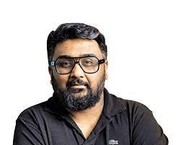
ABOUT KUNAL SHAH
-> Kunal Shah is an entrepreneur and founder of Free-Charge, an e-commerce website providing the online facility to recharge any prepaid mobile phone, postpaid mobile, DTH and Data Cards in India.
-> Kunal Shah is an angel investor and has invested in 40-50 companies, with the intent to learn, work with the entrepreneurs and to help them.

Slide 3
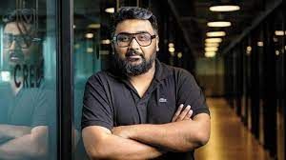
Education
-> Kunal Shah graduated with a Bachelor of Arts degree in Philosophy from Wilson College, Mumbai and briefly pursued an MBA from SVKM’s NMIMS before dropping out. He started his career as a junior programmer at a business process outsourcing startup. Shah’s first startup venture was a company called Paisa-back, which provided cash-back promotions for retailers.

Slide 4
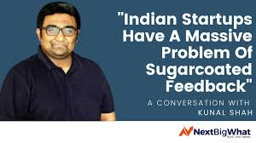
What He Believes
-> “Startups in India are so good at creating solutions, they spend very little time understanding the problem” says Kunal Shah, Co-Founder of Free-Charge which was one of India’s most innovative business models. Shah who spent years doing consumer surveys and behavior analysis before launching Free-Charge in 2011, is an ardent believer of “Plan better than fail fast” strategy.

Slide 5
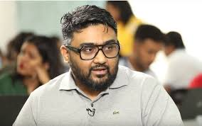
Challenges Faced By Kunal
-> While establishing free charge, Kunal shah has faced many problems. People at first thought it ‘s a jugaad and he came across many hurdles and he tried so much to understand the mindset of big companies.
-> Eventually, some of these companies saw the benefits they could reap through such a model and the rest tagged along as soon as they saw others on board.
-> There were also some issues related to integration of the payment gateways with their website as well. But anyway, these problems eventually faded and situations smoothened out!

Slide 6

Success Story Of Kunal Shah
-> Cred, an Indian fintech organization situated in Bangalore which permits clients to make credit card installments through its application for which they get cashback, coins, and other rewards. Afterward, CRED added provisions to permit clients to make house lease installments and presented momentary credit lines.

Slide 7
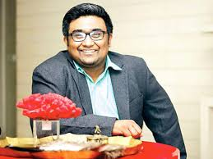
KUNAL SHAH NET WORTH
Kunal Shah net worth in 2021 is 809 Million Dollars. He is a Serial Entrepreneur, who started back in 2009 with his venture PaisaBack and free charge in 2010. Freecharge was his biggest stint which was later sold successfully to snapdeal for $400 million

Slide 8
What do CRED App does?
Cred App helps user to earn reward points every time they pay their credit card bill
Cred app Tracks all your credit card dues and sends you timely payment reminders to help users pay their bills on time.
The app also inform about unexpected fees or charges that have been charged on user credit card.
However, not everyone is eligible to use the cred app. The cred app only used that user who has a credit score of more than 750
The Cred app provides rewards in the form of cred coins which can be redeemed in the form of cash/reward from brands you love. Ex –
Today cred has more than 30 lakh users, and cred is already processing 20% of all the premium credit card transactions.

Slide 9
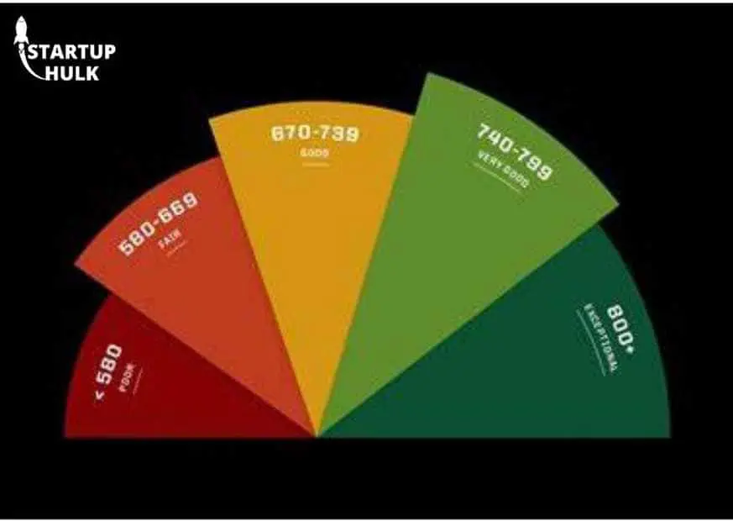
Graphical Representation

Slide 10

What’s the Problems cred business model solves & what benefits they provide to the users
Hidden charges – Cred shows all the hidden charges that banks regulate on the user’s credit cards. And help in saving their money from all hidden charges.
Late fees – users no longer remember paying their credit card bill; they no longer have to remember when exactly their due dates, so Cred reminded the user to pay the credit card fees on time.
Extra interest cred help in from paying extra interest through Pay automatic credit bill on time with the help of their user Email address.
So, Cred provides these incentives in order to get the customer to use their product, eventually, to increase their user base customers.

Slide 11
Thankyou
Hope Everyone will become an entrepreneur and reaches to higher position☺

